Slide 1

Blueprints For A Serpent
An Exploration Of Python Variants
Alternate Title: “How To Mek Snek”

Slide 2


Who Am I?
Taylor Bird
Been coding a while
Like to stay curious
Work at Excella with others that feel the same way

Slide 3
Why This Topic?
In Remembrance Of:
Professor Bob Noonan (1944-2018)
Co-founder William and Mary C.S. Department
Professor of my Comparative Programming Languages Class
Thank you for teaching me.

Slide 4

Because I ALREADY KNOW YOU can’t get enough
https://github.com/nsubordin81/educational-python-variants

Slide 5
Language Specifications
Working Definition:
Consensus For What A Language Is And What It Isn’t
Things That Are (Mostly*) The Same Across Implementations:
Syntax
Types
Semantics
Things That Change:
Nature of compilation, interpretation and execution
Available features
* The alternate implementation might be a superset or subset

Slide 6
Reference Implementation
Usually Comes Before Specification/Standard.
People See It As The Concrete Companion To The Specification.
It Is The Most Widely Used.
It Is The Most Up To Date.
Other Implementations Aim To Be Compatible With It.
For Python This is CPython.

Slide 7
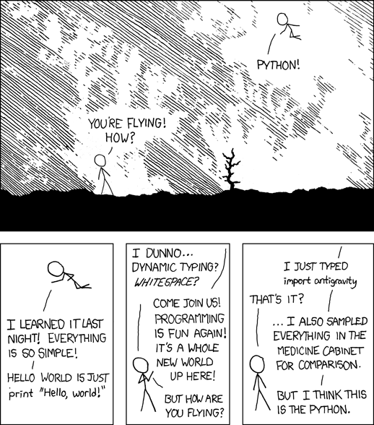
ISN’T One Enough?
It’s actually pretty great that you can implement your own python when CPython doesn’t meet your needs
Guido Van Rossum (original author and BDFL emeritus) has dedicated much of his life to improving CPython but he recognizes and endorses variants
https://xkcd.com/license.html

Slide 8

No Really, Why Isn’t one enough?
https://xkcd.com/license.html
CPython May Not Meet Your Performance Needs (Pypy, Cython, Numba, etc.)
You Want To Have Python and Another Language Talk To Each Other (Jython, Iron Python)
You Think CPython Would Be Better If Only. . . (Stackless Python, Pypy, Adding Paradigm Bias)

Slide 9
What The Programmer Really Cares About
➔
➔
program Meks snek
My Fantastic Source Code To
Mek snek
Something Magic Happens

Slide 10
But we have to go deeper. . .

Slide 11
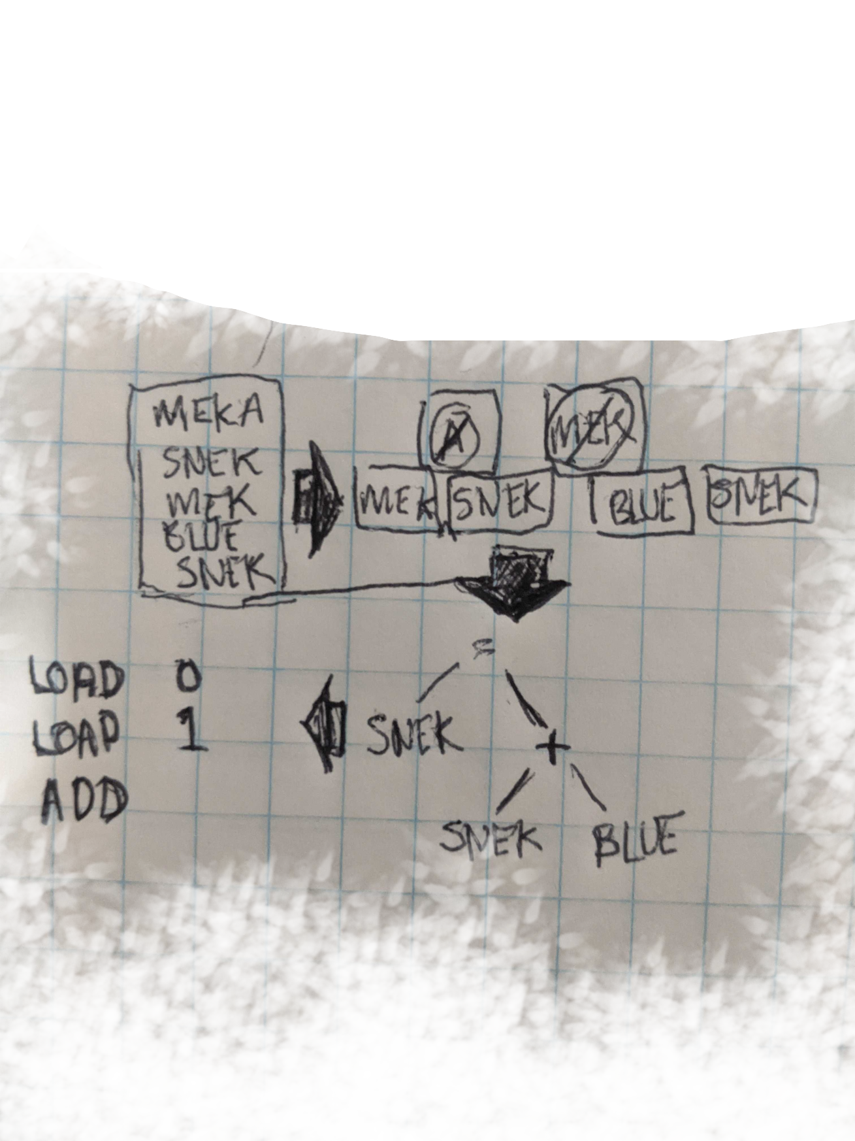
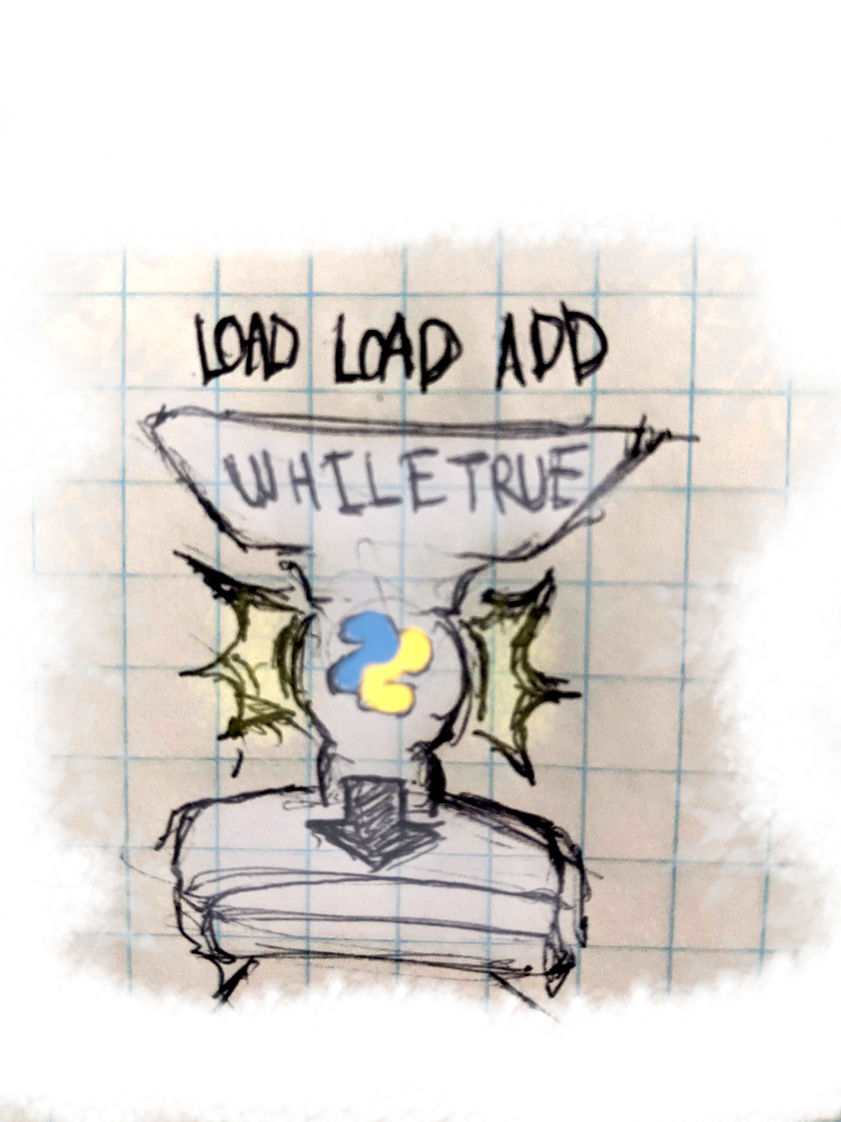
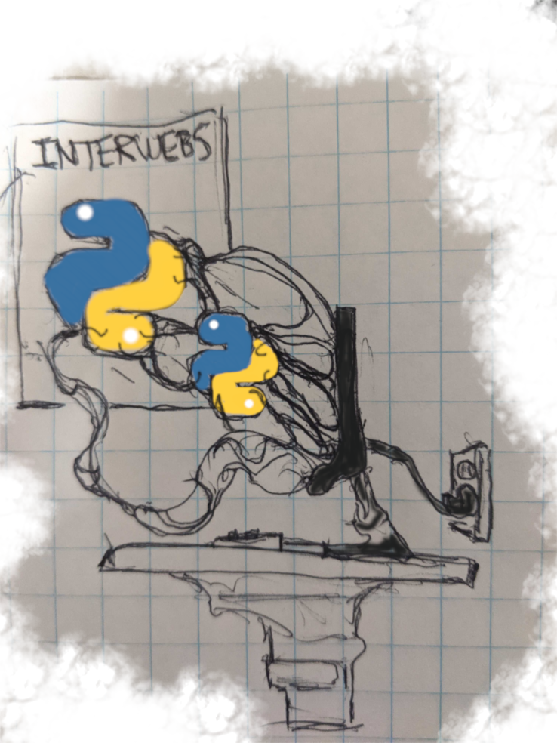
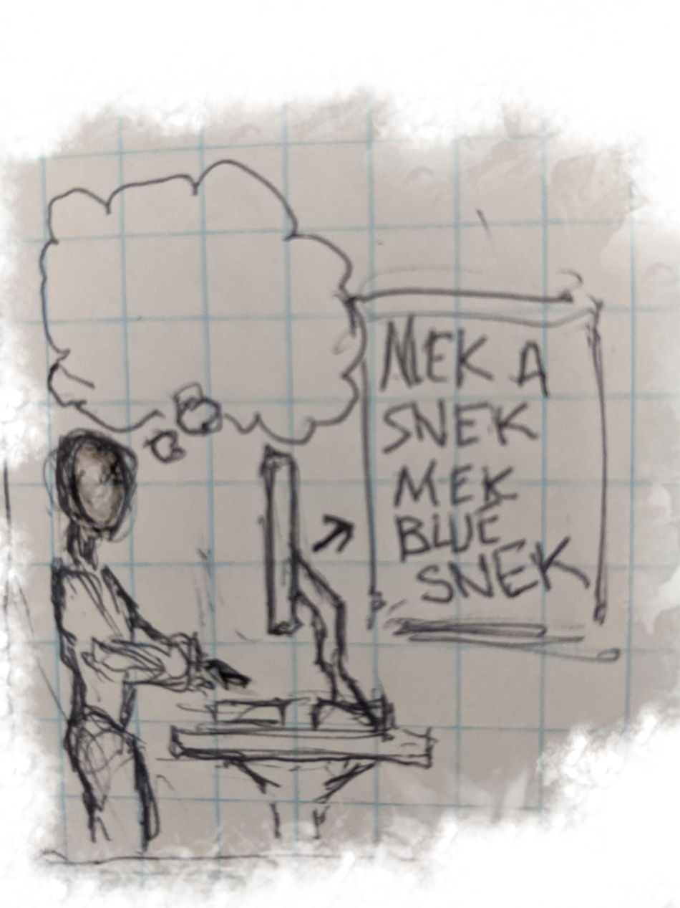
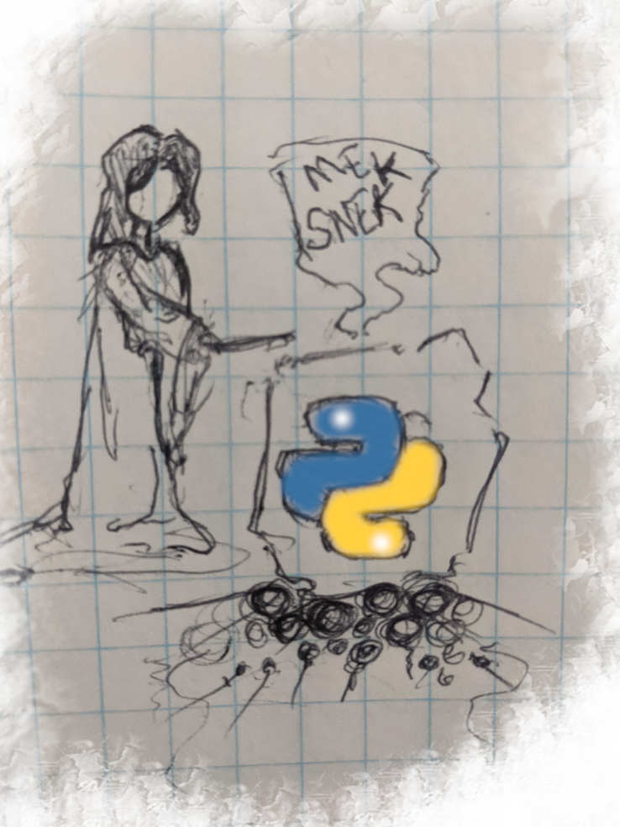

Cpython Interpreter as a series of conversations
Interpreter author to their machine
Programmer to target machine
Programmer to the interpreter
Interpreter to itself (compile)
Interpreter to itself (VM)
It gets rid of symbols that don’t matter, make sure sequence is valid, fit it into a concise, unambiguous form (AST), generate bytecode instructions.
On their machine, they downloads and installs the interpreter of that python version that was compiled to work on their system’s OS and architecture
they writes some source code. Close to natural language, messy and ambiguous, just the way we humans like it
It loops through the bytecode instructions, execute them on that really smart C program that was made in conversation 1
On her machine, she Compiles her really smart C program that knows how to compile any python of a particular version and translate its instructions into a semantically similar C instruction on the fly then uploads it for distribution

Slide 12
So what can we change?

Slide 13
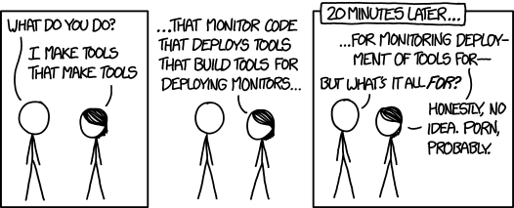
Get Rid Of the stack, stackless python
Key Insight 1: Although The CPython Interpreter Needs The Runtime Stack because it is a C program, The emulated program that the bytecode represents can be run more flexibly, like with save points on the stack and actual execution context on the heap
Key Insight 2: If You Free Yourself Of The First-In First-Out -ness of the Runtime Stack, You Can Have Continuations, which practically means cooperative and preemptive multitasking that is lighter weight than threads (or even fibers)
https://xkcd.com/license.html

Slide 14

Stackless, what do you get?
A game that can have 10,000+ concurrent users
On a single server, one copy of the game world for all 300K players https://www.engadget.com/2008-09-28-eve-evolved-eve-onlines-server-model.html#:~:text=EVE%20Online%20is%20unique%20among,a%20massive%20cluster%20of%20servers.
Pickling the state of tasklets to pass partially completed functions between interpreters running on different machines
A webserver where tasklets are cooperative components that pause for I/O from the user but otherwise create separate views and publish them. Instead of writing a bunch of separate controllers to handle control flow according to your routes, you can centralize imperative (intuitive) control flow logic like you would for a desktop app. https://nagare.org

Slide 15
Rewrite the interpreter, Add just-in-time compilation, revolutionize dynamic language creation, Pypy/rpython
Key Insight 1: If you restrict a high level language like Python enough to allow it to be statically analyzed, you could write an interpreter in python with a toolchain that compiled it down to C
Key Insight 2: Given some high level hints in your interpreter code you could leverage that same toolchain to generates a Just-In-Time Compiler so your interpreter could translate the bytecode it gets directly to machine code!! Head explodes more!
Key Insight 3: Nothing about that is specific to python, you can generalize it to other
Interpreted languages you might write! So many heads, such exploding.

Slide 16
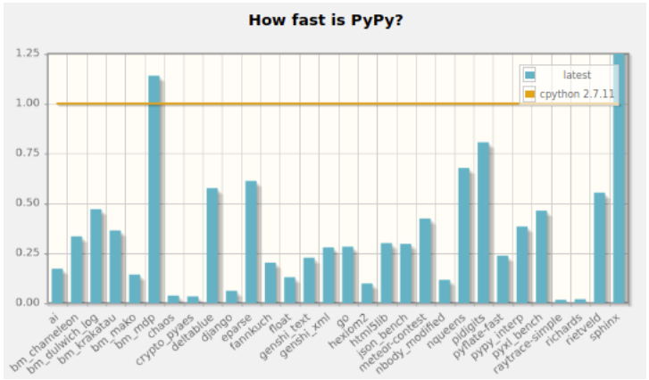
Pypy, what do you get?
Use-Case Dependent Speed Multiplier and/or Memory Efficiency.
Average 4.4x speed up across benchmarks
It Passes compatibility test suite for CPython 2.7.18 and 3.7.9
C-Extensions must be recompiled though
Oh! It Also Has A Stackless Mode

Slide 17
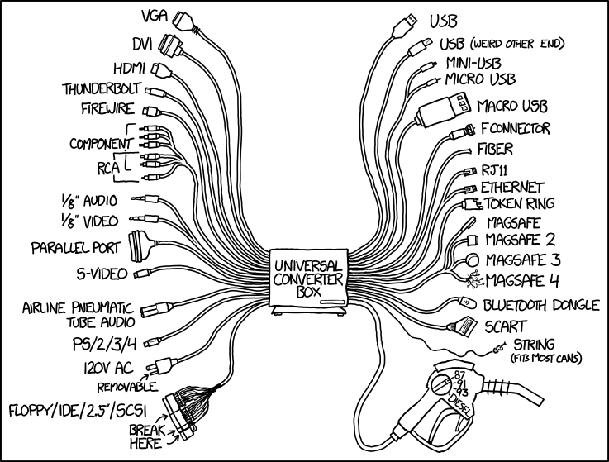
Change the bytecode and vm/runtime to another language, java, .net
Key Insight 1: Python Syntax And Semantics Could be Compiled to a different intermediate format
(like a different bytecode)
Key Insight 2: If that other language already has its own runtime environment, then you could write the compilation portion such that the resulting program could be some mixture of python and that other language
https://xkcd.com/license.html

Slide 18
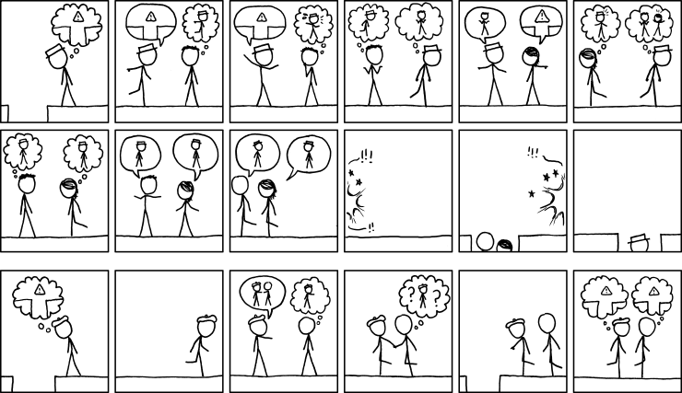
Iron Python, java, what do you get?
A Python Interactive Runtime Interpreter where you can write python code that can call your C# Assemblies or Java Libraries and operate on C# or Java Types
A Way To Embed The Python Interpreter Into Your
Code So That Your Java or .Net Application Can
Run Modules Scripted In Python
Faster Development Once People Get Used To It, also
Creative things like scripting tools for tests, easier fakes and mocks and a python test bed that runs your Java application and makes alterations to it at runtime so you can assert on how the system reacts
https://xkcd.com/license.html

Slide 19
You could write a compiler to translate cpython to a faster language, cython
Key Insight 1: You could create a language that is pretty much python but allows additional optimization annotations like C/C++ type declarations
Key Insight 2: having a compiler like this allows you build C code with python that can be dynamically linked back to the CPython interpreter at runtime, so you are effectively removing a lot of the pain of wrapping python code in a C/C++ extension

Slide 20
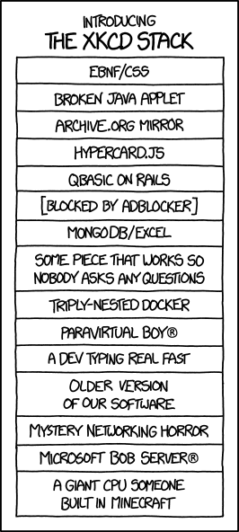
These All Seem Really Cool, why even use cpython anymore?
Cpython Will Probably Always Be The Most Stable and Up To Date, Catering To The Most General Use Cases, Best Ease Of Use And Highest Productivity.
To Differing Degrees, Other Implementations Have Learning Curves
And Compatibility Problems Only Worth It If Your Use Case Needs
What They Bring
Just like you would with a third-party lib, feel free to experiment, but be willing To admit when it wasn’t a good fit. You don’t want your teammates saying something like:
“They convinced us to use Pypy and wouldn’t give up on it when some of our C Extensions broke, now we are rewriting them all in CFFI.”
https://xkcd.com/license.html

Slide 21
Some of the Python Variants We Didn’t Cover
Numba – Similar goal to Cython in that you can decorate python with optimizations, but then you annotate your code instead of compiling it and you get the speed up at runtime. It used to tail Cython on benchmarks but now it seems to have mostly caught up and passed in some cases.
Python.Net – While IronPython and Jython take the approach of compiling to a different bytecode and swapping the runtime, Python.Net keeps the Cpython runtime which historically made
ShedSkin - A python to C++ compiler that takes in python with static type declarations. Resulting code runs faster than even JIT compiler benchmarks
Starkiller – 2004 MIT graduate thesis for a statically-typed, compiled version of python, implemented proof of concept but not developed and maintained
RubyPython – bridge between python and ruby VMs, different approach for higher level language compatibility

Slide 22
attributions
The header font for this presentation was “Rough Draft computer font v1.0” ©2002 Harold Lohner https://haroldsfonts.com/
In case you missed it, there were a lot of XKCD comics by Randall Monroe which I shared under this https://xkcd.com/license.html
In the companion repo, You’ll find citations and links to two or three books, several youtube talks, language docs and articles without which this presentation would have probably just been a few minutes of me turning more and more red until I passed out. https://github.com/nsubordin81/educational-python-variants
Found the Snake drawing on a public domain clipart site and did some fun things with it in GIMP https://www.pngkit.com/view/u2w7e6w7o0e6u2u2_snake-head-tattoo-drawings-realistic-snake-drawing/
Kthx!

